Slide 1
Apache Spark: Beyond Hadoop MapReduce
Presenter: Vishal

Slide 2
What will you learn today?
Strength of MapReduce
Limitations of MapReduce
How MapReduce limitations can be overcome
How Spark fits the bill
Other exciting features in Spark

Slide 3
Strength of MapReduce

Slide 4

Strength of MapReduce
Simple
Independent of a programming language, such as Java, C++ or Python.
Minimal
data
motion
Scalable
It can process petabytes of data,
stored in HDFS on one cluster
Process moves towards data to minimize Disk I/O
Fault
Tolerant
MapReduce takes care of failures
using the replicated copies.

Slide 5
Limitations of MapReduce

Slide 6

Limitations Of MR
Real
Time
Random
Access
Graph
Processing
Minimal
Data
Motion
Iterative
Tasks
Complex
Algorithm
Re-reading
and parsing
Data

Slide 7
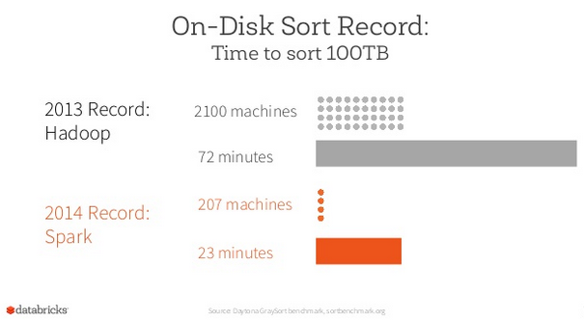
Feature Comparison with Spark
Hadoop MapReduce
Hadoop Spark
Fast | 100x faster than MapReduce
Batch Processing | Batch and Real-time Processing
Stores Data on Disk | Stores Data in Memory
Written in Java | Written in Scala
Source: Databrix

Slide 8
What are the MR limitations and how Spark overcomes it?

Slide 9




Overcoming MR limitations
Overhead
Reading,
parsing
Real
time
By Cutting down on the number of Reads and Writes to the disc

Slide 10

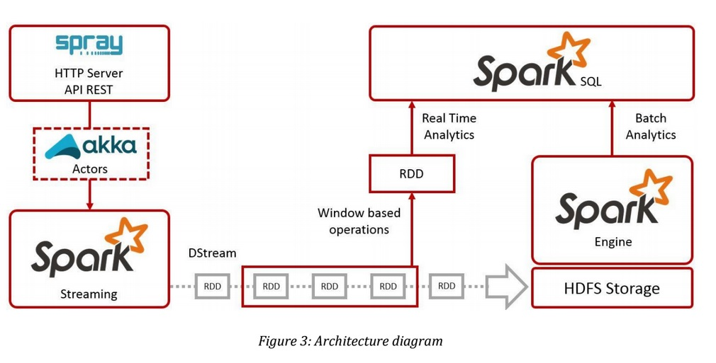
Spark Cuts Down Read/Write I/O To Disk
Spark tries to keep things in-memory of its distributed workers, allowing for significantly faster/lower-latency computations, whereas MapReduce keeps shuffling things in and out of disk.

Slide 11
Overcoming MR limitations
Complex
algorithm
Graph
processing
Libraries for Machine
Learning & Streaming

Slide 12
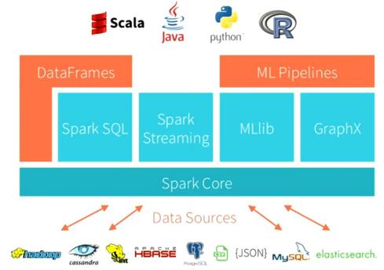
Libraries For ML, Graph Programming …
Utility for continuous ingestion of data
Graph programming
Spark interface
For RDBMS lovers
Machine Learning
Library

Slide 13
Overcoming MR limitations
Iterative
tasks
Random
access
Cyclic data flows

Slide 14
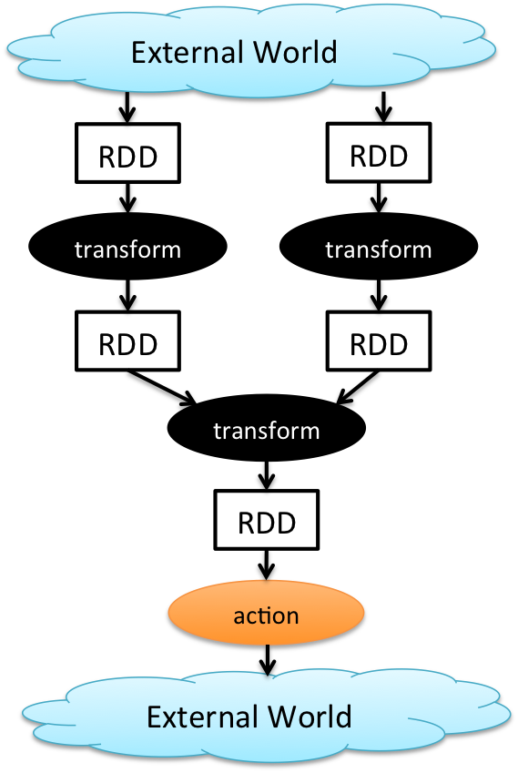
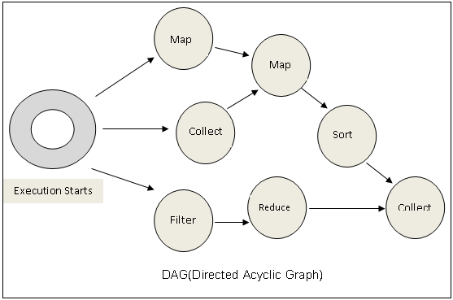
Cyclic Data Flows
All jobs in spark comprise a series of operators and run on a set of data.
All the operators in a job are used to construct a DAG (Directed Acyclic Graph).
The DAG is optimized by rearranging and combining operators where possible.

Slide 15

Spark Features makes its Architecture better than MR

Slide 16
Other Spark Features In Demand

Slide 17
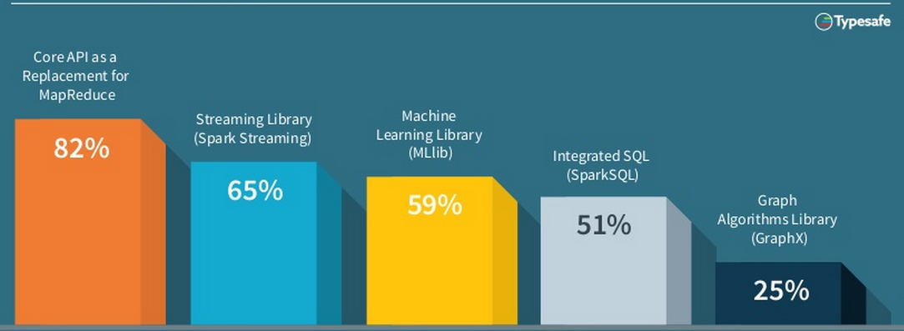
Spark Features/Modules In Demand
Source: Typesafe

Slide 18

New Features In 2015
Data Frames →
Similar API to data frames in R and Pandas
Automatically optimised via Spark SQL
Released in Spark 1.3
SparkR →
Released in Spark 1.4
Exposes DataFrames, RDD’s & MLlibrary in R
Machine Learning Pipelines →
High Level API
Featurization
Evaluation
Model Tuning
External Data Sources →
Platform API to plug Data-Sources into Spark
Pushes logic into sources
Source: Databrix
Notes:
http://www.information-management.com/gallery/Big-Data-Hadoop-2015-Predictions-Forrester-10026357-1.html
https://www.forrester.com/Predictions+2015+Hadoop+Will+Become+A+Cornerstone+Of+Your+Business+Technology+Agenda/fulltext/-/E-RES117705

Slide 19

Get Certified in Spark from Edureka
Go to www.edureka.co/apache-spark-scala-training
Batch starts from 10th October (Weekend Batch)
Edureka's Spark and Scala course:
Learn large-scale data processing by mastering the concepts of Scala, RDD, Traits, OOPS and Spark SQL
Online Live Courses: 24 hours
Assignments: 32 hours
Project: 20 hours
Lifetime Access + 24 X 7 Support

Slide 20
Thank You
Questions/Queries/Feedback/Survey
Recording and presentation will be made available to you within 24 hours

